Slide 1
1. Fundamentals of Agile project management methodology
(4 hours)

Slide 2
Summary
1.1 Agile taxonomy (1.5 hours)
1.2 Managing a project with an Agile approach (2.5 hours)

Slide 3
1.1 Agile taxonomy (1.5 hours)

Slide 4
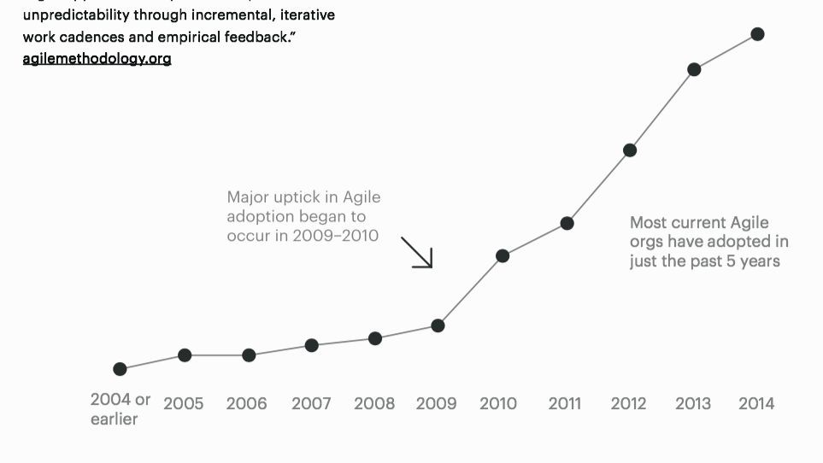
The birth of agile methodology

Slide 5

The birth of agile methodology
Between 11 and 13 February 2001, 17 people stayed at a Utah resort. For what purpose? Finding a different way of working.

Slide 6

The birth of agile methodology

Slide 7

The birth of agile methodology

Slide 8

The birth of agile methodology

Slide 9
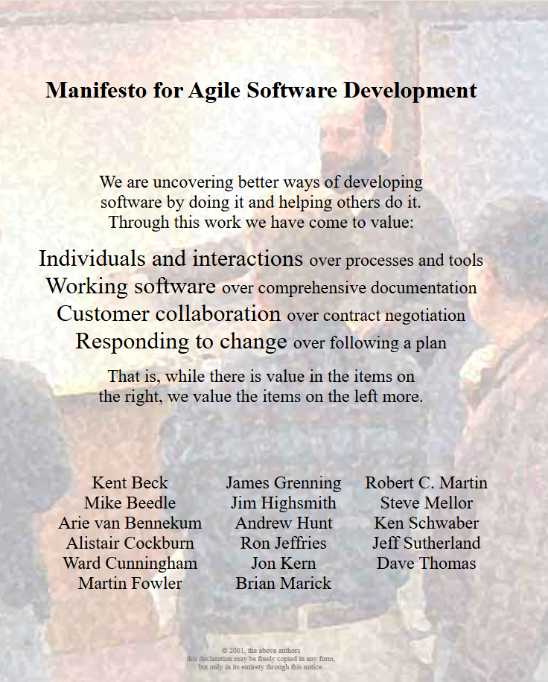
The birth of agile methodology
In computer engineering, 'agile software development' refers to a set of development methods that have emerged since the early 2000s and are based on the principles of the so-called 'Agile Manifesto'.

Slide 10
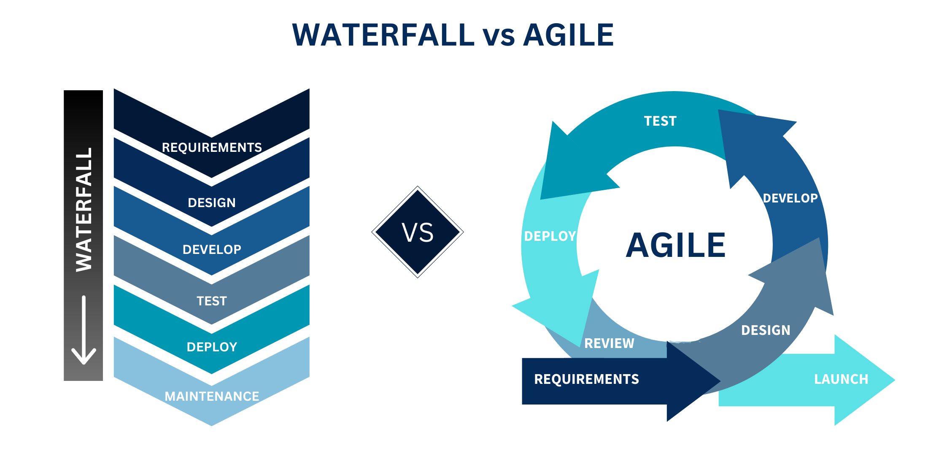
Key principles of agile project management
Agile methods, as opposed to traditional (waterfall) methods, propose a less structured approach aimed at releasing functioning and quality software quickly and frequently

Slide 11
Key principles of agile project management
1. Customer value first: making sure that the project, product and team values are aligned to release quality products faster and more cost-effectively
2. Small functionalities: create a stream of complete functionalities, released to the customer incrementally over the life of the project

Slide 12
Key principles of agile project management
3. Small, integrated working groups: intensive collaboration through close placement and face-to-face communication; roles are diversified within integrated, self-organised groups and self-disciplined
4. Small and continuous improvements: teams reflect, learn and adapt to change; work influences the plan

Slide 13
Key principles of agile project management
What does this have to do with project management?
Agile' approaches help teams (not only IT) to respond to uncertainty...
through incremental and iterative work cycles, accompanied by empirical feedback
(agilemethodology.org)

Slide 14
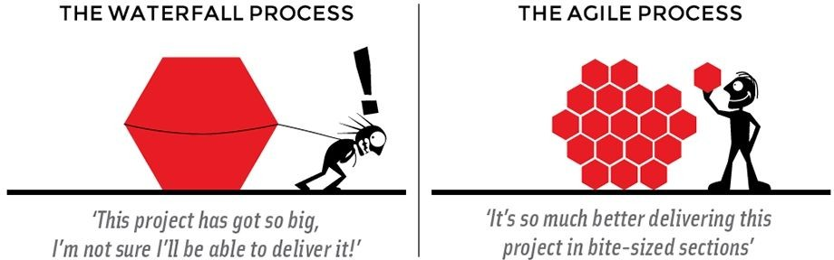
Where to start?

Slide 15
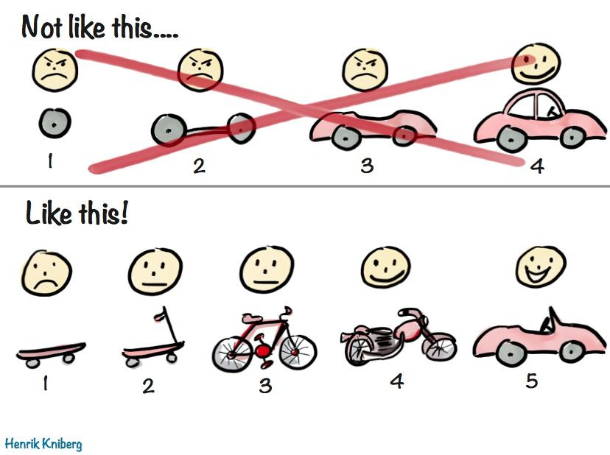
1. Minimum Viable Product (MVP)
When developing an innovative product, the Minimum Viable Product (MVP) is the product with the highest return on investment relative to the risk.

Slide 16
1. Minimum Viable Product (MVP)
More than a product, an MVP is a strategy and an iterative process of idea generation, prototyping, presentation, data collection, analysis and learning for the purpose of:
test product hypotheses with minimal resources
accelerate learning about market dynamics
reduce engineering hours
give early adopters a product as soon as possible
Note: An MVP (≠ Activity to be performed = task) cannot be described by an action!

Slide 17
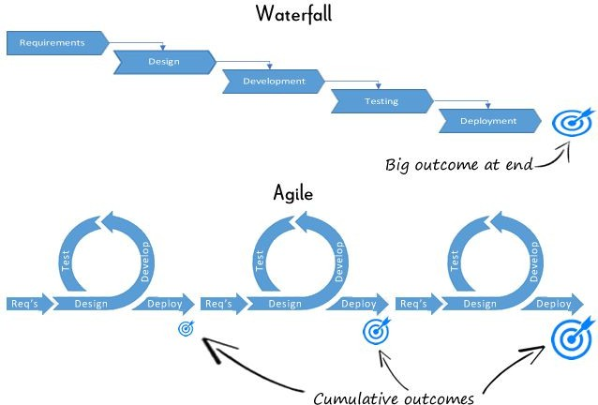
2. Iterations

Slide 18
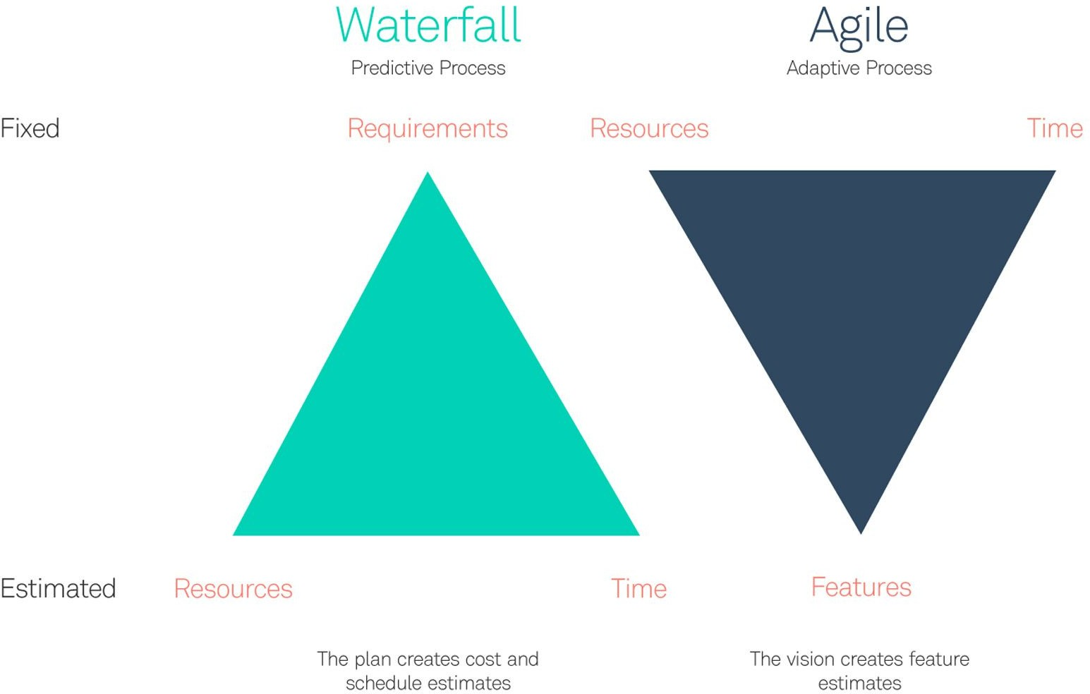
3. Adaptation

Slide 19
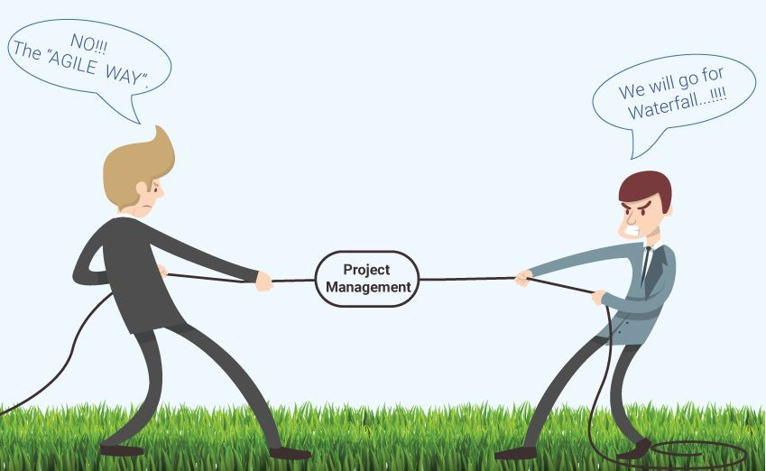
So abandoning traditional logic?
No, each approach has its own validity!

Slide 20
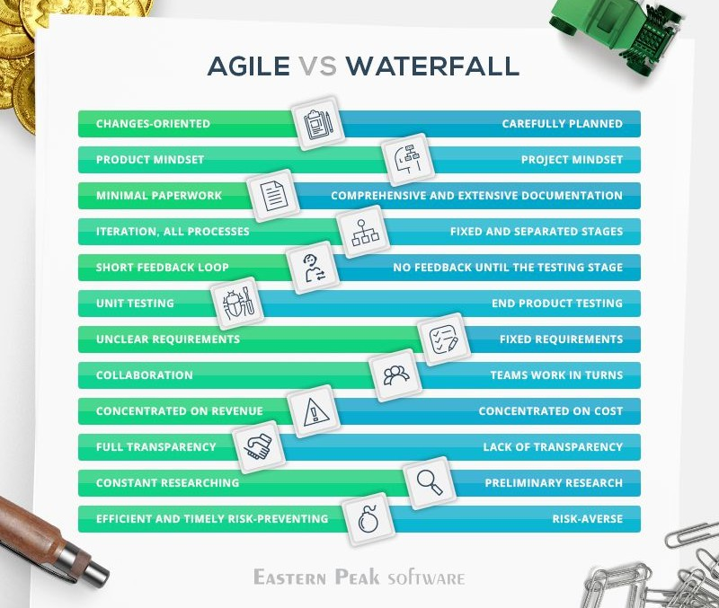
So abandoning traditional logic?

Slide 21
Agile or Lean?
High
AGILE
 | LEAN
Tending to... | When...
LEAN | Processes are rather 'stable' and known, and developed in contexts of moderate variability. They should be optimised because the production volumes associated with them are high.
AGILE | Processes are subject to less predictability and greater variability. E.g.: new market entry, R&D, contract machining, etc.
CONTEXT VARIABILITY
Low
PRODUCTION VOLUME
High

Slide 22
1.2 Managing a project with an Agile approach (2.5 hours)

Slide 23
Introduction to the Agile approach
What is Agile?
An iterative approach to project management and software development.
Focuses on collaboration, customer feedback, and small, rapid releases.
Why Agile?
Adaptable to change
Increases stakeholder involvement
Delivers value early and often

Slide 24
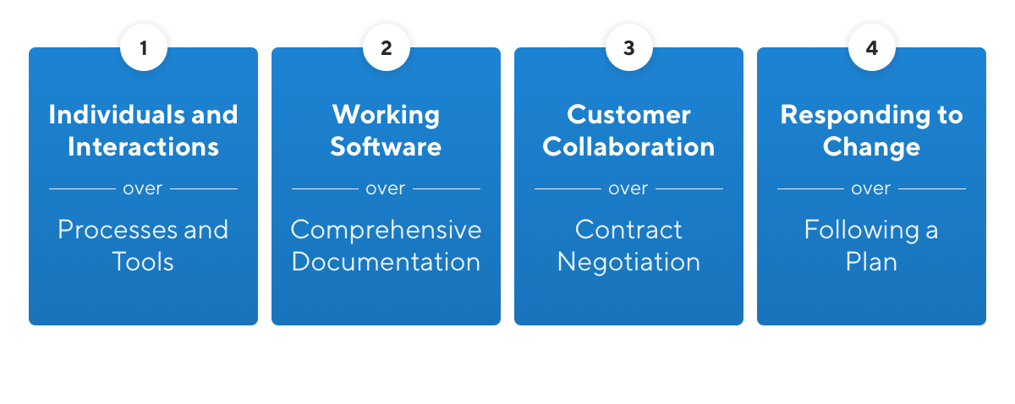
Introduction to the Agile approach
Based on the Agile Manifesto – 4 core values

Slide 25
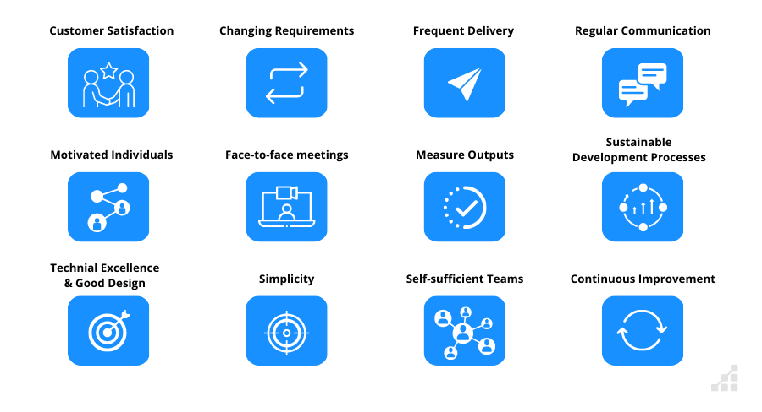
Introduction to the Agile approach
Based on the Agile Manifesto – 12 principles

Slide 26
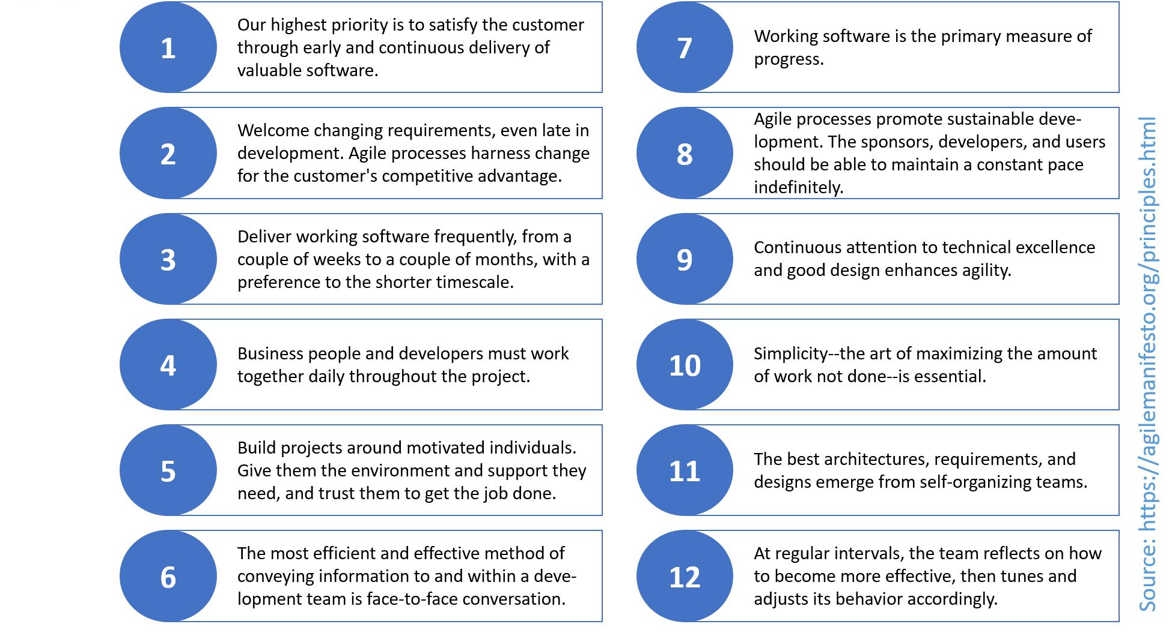
Introduction to the Agile approach
Based on the Agile Manifesto – 12 principles

Slide 27
Managing a project with an Agile approach
Agile project management involves breaking projects into smaller, manageable units. Each unit delivers a piece of working software or value. It encourages collaboration, continuous feedback, and flexibility to adapt to changes.
Key principles include:
Customer collaboration over contract negotiation
Responding to change over following a plan
Individuals and interactions over processes and tools
Working solutions over comprehensive documentation

Slide 28
Managing a project with an Agile approach
1. Project Initiation Define goals, team, and stakeholders.
2. Planning Develop a product backlog, identify sprints.
3. Execution Deliver work in short iterations (sprints).
4. Monitoring Daily stand-ups, sprint reviews, retrospectives.
5. Closure Final product delivery, team assessment, documentation.

Slide 29
Managing a project with an Agile approach
Best practices
Foster communication
Keep backlog updated
Deliver MVPs
Conduct retrospectives
Balance flexibility and discipline

Slide 30
Managing a project with an Agile approach
Benefits
Faster time to market
Improved customer satisfaction
Better risk management
More engaged teams
Continuous improvement

Slide 31
Managing a project with an Agile approach
Challenges
Scope creep without discipline
Misunderstanding Agile roles
Resistance to change
Lack of experienced leadership

Slide 32
Case study - Project Description
Company: marketing agency based in Croatia
Industry: e-commerce
Technologies used:
Asana
Shopify
JavaScript
PHP
C#
SQL
REST API
GraphQL

Slide 33
Case study - Project Description
As project managers, we were engaged to lead the end-to-end implementation of a fully customized ERP system and its integration with a Shopify-based e-commerce platform for a retail company. The ERP solution was developed from scratch, including modules for POS operations, inventory management, warehouse logistics, and accounting.
In parallel, we managed the development of the online store on Shopify, ensuring seamless integration with the ERP backend. Key e-commerce features included integrations with multiple delivery services, secure credit card payment setup, a unified customer loyalty system (shared between physical stores and online purchases), and automated gifting based on order thresholds.
The project involved selecting and coordinating with specialized development partners, overseeing timelines, technical alignment, and stakeholder communication, ensuring a scalable and future-proof solution that connected physical and digital sales channels.

Slide 34
Case study - What were the biggest challenges in the project, and how were they addressed?
One of the initial challenges was choosing the right technologies to build the ERP and e-commerce systems. The decision was left to us as project managers, with the requirement to balance a limited budget with the client’s wish for a modern and easy-to-maintain solution. While Magento was the most suitable platform in terms of flexibility and features, budget constraints led us to opt for Shopify as a more feasible alternative.
Another major challenge was finding a development partner capable of delivering a highly customized Shopify web shop that went far beyond standard features. It was crucial to find a company familiar with the local Croatian market, including legal requirements and logistical standards.

Slide 35
Case study - Which project management methodology was used and how was it adapted to the project?
We used a Hybrid project management approach. The project started with a clearly defined plan and deadlines (Waterfall), which helped align all stakeholders and set realistic expectations. However, within those parameters, we adopted Agile principles—adjusting priorities and iteratively developing functionalities as requirements evolved.
Given the scope and the fact that large teams worked on different components (e.g., ERP modules and web shop frontend/backend), we were also able to run several tasks in parallel, which significantly improved efficiency and shortened delivery time.

Slide 36
Case study - What were some key decisions made during the project?
One of the key decisions - typical for many e-commerce projects - was to not wait for the design and all functionalities to be 100% polished before going live. Due to the complexity of the loyalty program that connected both physical stores and the web shop, it wasn’t feasible to test every scenario fully in a pre-production environment.
Instead, we launched the web shop with some known and acceptable risks, understanding that some minor issues might surface once it was live. All stakeholders agreed with this approach, and it turned out to be the right decision: the shop started generating revenue for the Client immediately, while we fixed and refined things in the background.

Slide 37
Case study - What were the main project outcomes?
The project successfully delivered a custom ERP system tailored to the Client’s internal workflows (inventory, accounting, logistics, in-store POS), as well as a high-performing Shopify web shop integrated with multiple delivery services and a card payment gateway.
A key outcome was the implementation of a unified loyalty system, allowing customers to collect and redeem points both online and in physical stores, under a single customer profile.
The systems are now connected and stable in production, the Client has full control over operations, and the digital sales channel has started generating revenue as planned.

Slide 38
Case study - What lessons were learned, and what would you do differently in the future?
One key lesson was that it’s not enough to trust what's officially available on paper - you need to understand how a market actually functions in practice.
While expanding the e-commerce project from Croatia to Slovenia and North Macedonia, we assumed the infrastructure would be comparable. But in reality, North Macedonia was significantly behind in digital development, especially regarding card payments on platforms like Shopify.
The biggest surprise was that there were no native payment gateways compatible with Shopify, and international ones weren’t accepted by local banks or carried unsustainable fees. What seemed technically feasible turned out to be a regulatory and logistical maze.

Slide 39
Case study - What lessons were learned, and what would you do differently in the future?
In the end, we implemented a custom workaround with a Serbian provider - something that worked in practice, though it wasn’t officially part of Shopify’s standard flow. It took over a year to solve something we initially estimated would take two weeks.
In future projects, especially in less digitized markets, we’ll invest more time upfront in mapping out local constraints and informal practices. That early insight could save months of delays and help us better set client expectations.

